Slide 1
Linked List

Slide 2
Linear Data Structures
Definition
A data structure is said to be linear if its elements form a sequence or a linear list.
Examples:
Array
Linked List
Stacks
Queues
Operations on linear Data Structures
Traversal : Visit every part of the data structure
Search : Traversal through the data structure for a given element
Insertion : Adding new elements to the data structure
Deletion : Removing an element from the data structure.
Sorting : Rearranging the elements in some type of order(e.g Increasing or Decreasing)
Merging : Combining two similar data structures into one

Slide 3
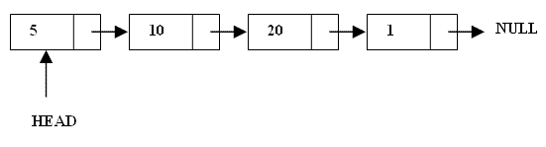

What are Linked Lists
A linked list is a linear data structure.
A chain of structures make up linked lists called Node.
Nodes are made up of data and a pointer to another node.
Usually the pointer points to a structure of the same type as itself

Slide 4
Arrays Vs Linked Lists
Arrays | Linked list
Fixed size: Resizing is expensive | Dynamic size
Insertions and Deletions are inefficient: Elements are usually shifted | Insertions and Deletions are efficient: No shifting
Random access i.e., efficient indexing | No random access → Not suitable for operations requiring accessing elements by index such as sorting
No memory waste if the array is full or almost full; otherwise may result in much memory waste. | Since memory is allocated dynamically(acc. to our need) there is no waste of memory.
Sequential access is faster [Reason: Elements in contiguous memory locations] | Sequential access is slow [Reason: Elements not in contiguous memory locations]

Slide 5
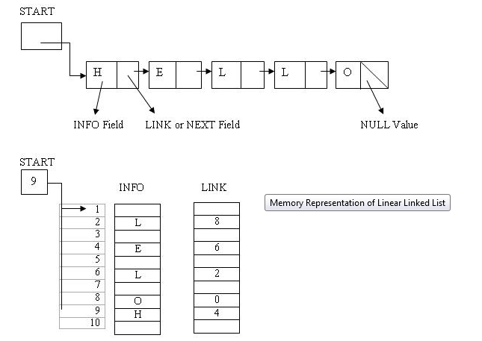
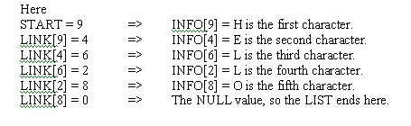
Representation of linked list in memory

Slide 6
Types of lists
There are two basic types of linked list
Singly Linked list
Doubly linked list
Circular linked list

Slide 7
Singly Linked List
Each node has only one link part
Each link part contains the address of the next node in the list
Link part of the last node contains NULL value which signifies the end of the node

Slide 8
Schematic representation
Here is a singly-linked list (SLL):
myList
a
b
c
d
Each node contains a value(data) and a pointer to the next node in the list
myList is the header pointer which points at the first node in the list

Slide 9
Basic Operations on a list
Creating a List
Inserting an element in a list
Deleting an element from a list
Searching a list
Reversing a list

Slide 10
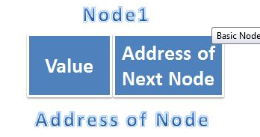
Creating a node
typedef struct {
int val; // A simple node of a linked list
struct node * next; // pointer to the next address
} node;

Slide 11

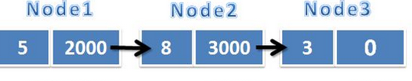
void create()
{
item * curr, * head,*tail;
head = NULL;
// beginning of loop
curr = (item *)malloc(sizeof(item));
curr-> val =read value;
curr->next = NULL;
if (head == NULL)
{
head = curr;
tail = curr;
}
else {
tail->next = curr;
tail = curr;
}
// end of loop;
}

Slide 12
To display
void display()
{
curr = head;
printf( "\n");
while(curr != NULL) {
printf(" %d---> ", curr->val);
curr = curr->next ;
} }

Slide 13
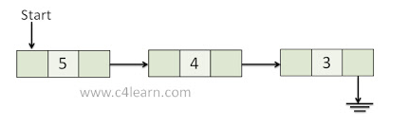
Traversing a Linked List
Traversing linked list means visiting each and every node of the Singly linked list. Following steps are involved while traversing the singly linked list –
Firstly move to the first node
Fetch the data from the node and perform the operations such as arithmetic operation or any operation depending on data type.
After performing operation, advance pointer to next node and perform all above steps on Visited node.

Slide 14
Inserting the node in a SLL
There are 3 cases here:-
Insertion at the beginning
Insertion at the end
Insertion after a particular node

Slide 15
Insertion at the beginning
There are two steps to be followed:-
Make the next pointer of the new node point towards the first node of the list
Make the start pointer point towards this new node
If the list is empty simply make the start pointer point towards the new node;

Slide 16
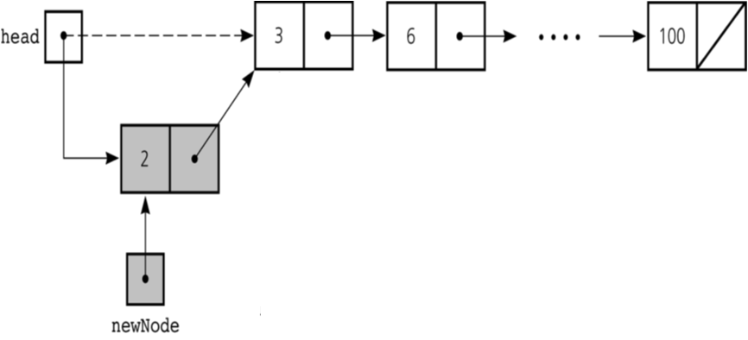
Insertion at the beginning

Slide 17
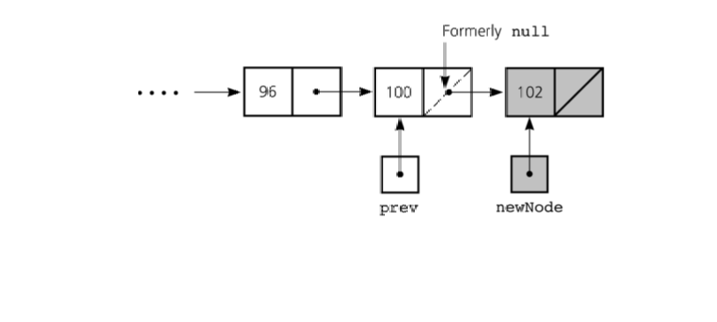
Inserting at the end
Here we simply need to make the next pointer
of the last node point to the new node

Slide 18
void insert_at_end() {
struct node *newnode,*current,*temp;
newnode=(struct node *)malloc(sizeof(struct node));
scanf("%d",&new_node->data);
newnode->next=NULL;
if(start==NULL) {
start=newnode;
current=newnode; }
else {
temp = start;
while(temp->next!=NULL) {
temp = temp->next;
}
temp->next = newnode; } }

Slide 19
Inserting after an element
Here we again need to do 2 steps :-
Make the next pointer of the node to be inserted point to the next node of the node after which you want to insert the node
Make the next pointer of the node after which the node is to be inserted, point to the node to be inserted

Slide 20
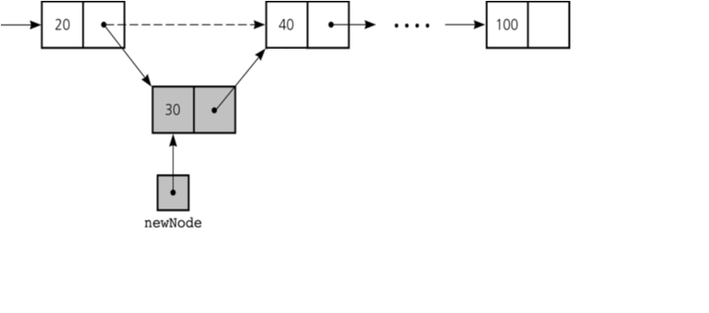

Slide 21
void insert_mid() {
int pos,i; struct node *new_node,*current,*temp,*temp1; new_node=(struct node *)malloc(sizeof(struct node));
printf("nEnter the data : "); scanf("%d",&new_node->data);
new_node->next=NULL;
printf("nEnter the position : "); scanf("%d",&pos);
if(start==NULL) { start=new_node; current=new_node; }
else { temp = start;
for(i=1;i< pos-1;i++) {
temp1 = temp;
temp=temp->next; }
temp1->next = newnode;
newnode->next=temp;
}

Slide 22
Deleting a node in SLL
Here also we have three cases:-
Deleting the first node
Deleting the last node
Deleting the intermediate node

Slide 23
Deleting the first node
Here we apply 2 steps:-
Making the start pointer point towards the 2nd node
Deleting the first node using delete keyword
start
one
two
three

Slide 24
void del_beg()
{
struct node *temp;
temp = start;
start = start->next;
free(temp);
}

Slide 25
Deleting the last node
Here we apply 2 steps:-
Making the second last node’s next pointer point to NULL
Deleting the last node via delete keyword
start
node1
node2
node3

Slide 26
void delete_at_end()
{
struct node *temp,*temp1;
if(start!=NULL) {
temp = start;
while(temp->next!=NULL) {
temp1 = temp;
temp = temp->next;
}
temp1->next = NULL;
delete(temp);
}
}

Slide 27
Deleting a particular node
Here we make the next pointer of the node previous to the node being deleted ,point to the successor node of the node to be deleted and then delete the node using delete keyword
node1
node2
node3
To be deleted

Slide 28
void delete_any()
{
struct node *temp,*temp1;
int key = data to be deleted;
if(start!=NULL) {
temp = start;
while(temp->next!=NULL and temp->data != key) {
temp1 = temp;
temp = temp->next;
}
if (temp->data == key){
temp1->next = temp->next;
delete(temp);
}
}
}

Slide 29
Searching a SLL
Searching involves finding the required element in the list
We can use various techniques of searching like linear search or binary search where binary search is more efficient in case of Arrays
But in case of linked list since random access is not available it would become complex to do binary search in it
We can perform simple linear search traversal

Slide 30
In linear search each node is traversed till the data in
the node matches with the required value
void search(int x)
{
node*temp=start;
while(temp!=NULL)
{
if(temp->data==x)
{
cout<<“FOUND ”<<temp->data;
break;
}
temp=temp->next;
}
}

Slide 31
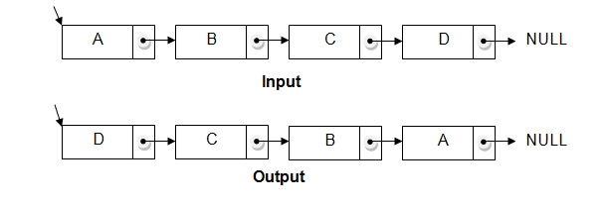
Reversing a linked list
We can reverse a linked list by reversing the direction of the links between 2 nodes

Slide 32
Doubly Linked List
1. Doubly linked list is a linked data structure that consists of a set of sequentially linked records called nodes.
2 . Each node contains three fields ::
-: one is data part which contain data only.
-:two other field is links part that are point
or references to the previous or to the next
node in the sequence of nodes.
3. The beginning and ending nodes' previous and next
links, respectively, point to some kind of terminator,
typically a sentinel node or null to facilitate traversal
of the list.

Slide 33
NODE
A B C
A doubly linked list contain three fields: an integer value, the link to the next node, and the link to the previous node.
previous | data | next
NULL | 11 | 786
200 | 656 | 400
786 | 777 | NULL
200
786
400

Slide 34
DLL’s compared to SLL’s
Advantages:
We can traverse in both directions i.e. from starting to end and as well as from end to starting.
It is easy to reverse the linked list.
If we are at a node, then we can go to any node. But in linear linked list, it is not possible to reach the previous node.
Disadvantages:
Requires more space
List manipulations are slower (because more links must be changed)
Greater chance of having bugs (because more links must be manipulated)

Slide 35
Structure of DLL
struct node
{
int data;
node*next;
node*previous; //holds the address of previous node
};
previous.inf
.Data
.next

Slide 36


Inserting at beginning

Slide 37
void insert_beg(node *p)
{
if(start==NULL)
{
start=p;
}
else
{
node* temp=start;
start=p;
temp->previous=p; //making 1st node’s previous point to the new node
p->next=temp; //making next of the new node point to the 1st node
}

Slide 38
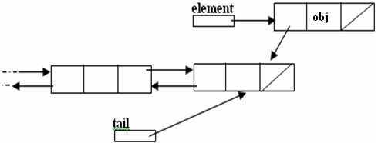
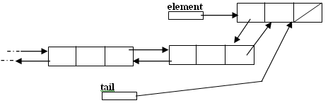
Inserting at the end

Slide 39
void insert_end(node* p)
{
if(start==NULL)
{
start=p;
}
else
{
node* temp=start;
while(temp->next!=NULL)
{
temp=temp->next;
}
temp->next=p;
p->previous=temp;
}
}

Slide 40
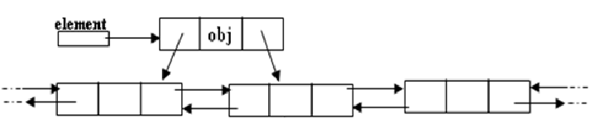
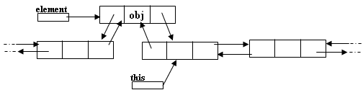
Inserting after a node
Making next and previous pointer of the node to be inserted point accordingly
Adjusting the next and previous pointers of the nodes b/w which the new node accordingly

Slide 41
void insert_after(int c,node* p)
{
temp=start;
for(int i=1;i<c-1;i++)
{
temp1 = temp;
temp=temp->next;
}
p->next=temp;
temp->previous=p;
temp1->next=p;
p->previous=temp1;
}

Slide 42
Deleting a node
Node deletion from a DLL involves changing two links
In this example, we will delete node b
myDLL
a
b
c
We don’t have to do anything about the links in node b
Garbage collection will take care of deleted nodes
Deletion of the first node or the last node is a special case

Slide 43
void del_at(int c)
{
node*s=start;
{
for(int i=1;i<c-1;i++)
{
s1= s;
s=s->next;
}
node* p=s;
s1->next=p->next;
p->next->previous=s1;
delete p;
}
}
}

Slide 44
APPLICATIONS OF LINKED LIST
1. Applications that have an MRU(most recently used) list (a linked list of file names) 2. The cache in your browser that allows you to hit the BACK button (a linked list of URLs) 3. Undo functionality in Photoshop or Word (a linked list of state) 4. A stack, hash table, and binary tree can be implemented using linked list.

Slide 45
THANK YOU

